Slide 1
Responsive Design
Bootstrap 1

Slide 2
Bootstrap 1
Prep Work
Finish Portfolio, Resume, and Landon Hotel Assignments and upload to the web server.
Link all projects from your portfolio page. (Photoshop (Fitness), (HTML) Safety, CSS (Landon Hotel)
Send instructor a link to the assignments.
Treehouse lesson: Responsive Layouts [47 min] https://teamtreehouse.com/library/responsive-layouts

Slide 3
Bootstrap 1
Today’s Topics
Introduction to Responsive Design
Layouts
Viewport
Media Queries
Intro to Bootstrap and Frameworks
Headings and Text
Forms
Splash Page

Slide 4
Responsive Web Design

Slide 5
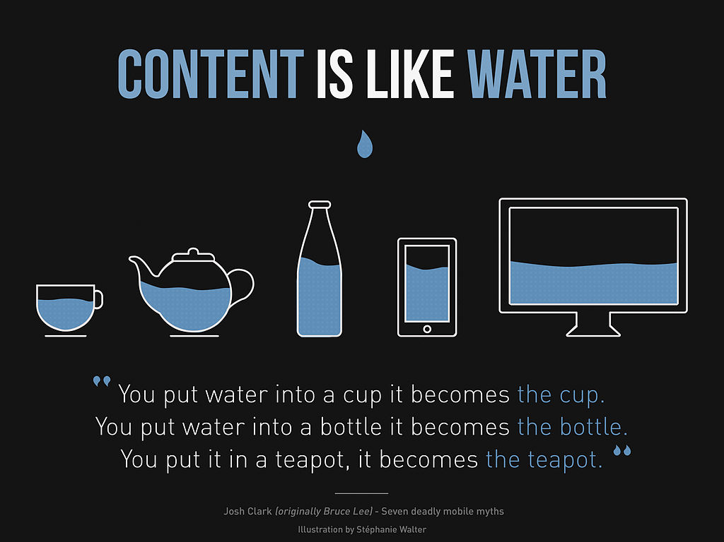
Bootstrap 1
Responsive Web Design:
The practice of building a website suitable to work on every device, or a design strategy that is centered on designing your content so that it responds to the environment it's encountered in.
Every screen size, no matter how large or small, mobile or desktop.

Slide 6
Bootstrap 1
Responsive Design was first coined by Ethan Marcotte who identifies three fundamental techniques for responsive design:
Fluid grids for flexible layouts
CSS media queries to help you adapt content to specific screen sizes (Small and Large not just handhelds)
Flexible images and media that respond to changes in screen sizes as well.

Slide 7
Bootstrap 1
Responsive Design Has 3 Parts
Fluid grids
Fluid Images
Media Queries

Slide 8
Bootstrap 1
Types Of Layouts
Fixed Layouts
Flexible Layouts
Adaptive / Responsive Layouts

Slide 9
Bootstrap 1
3 Types of Layouts (there are others)
Fixed - doesn’t change regardless of device, fixed pixel units
(2 column layout)(fixed.html and fixed layout.html examples)
Flexible- responds as browser size or screen changes. Limited when really large or really small. (2 column layout flex.html example)
Adaptive/Responsive- responds to browser window, orientation and height of device. (3 column layout based on size responsive.html example)

Slide 10
Bootstrap 1
CSS Units
CSS has several different units for expressing a length.
Many CSS properties take "length" values, such as width, margin, padding, font-size, border-width, etc.
Length is a number followed by a length unit, such as 10px, 2em, etc.
A whitespace cannot appear between the number and the unit. However, if the value is 0, the unit can be omitted.
For some CSS properties, negative lengths are allowed.
There are two types of length units: absolute and relative.
Absolute Lengths
The absolute length units are fixed and a length expressed in any of these will appear as exactly that size. Absolute length units are not recommended for use on screen, because screen sizes vary so much. However, they can be used if the output medium is known, such as for print layout.
For Example div {width:40px;}
Relative Lengths
Relative length units specify a length relative to another length property. Relative length units scales better between different rendering mediums. The em and rem units are practical in creating perfectly scalable layout!
For Example div {width:15em;} div {width:100%;}

Slide 11
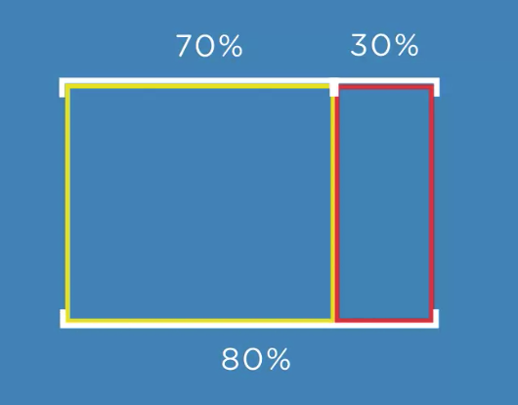
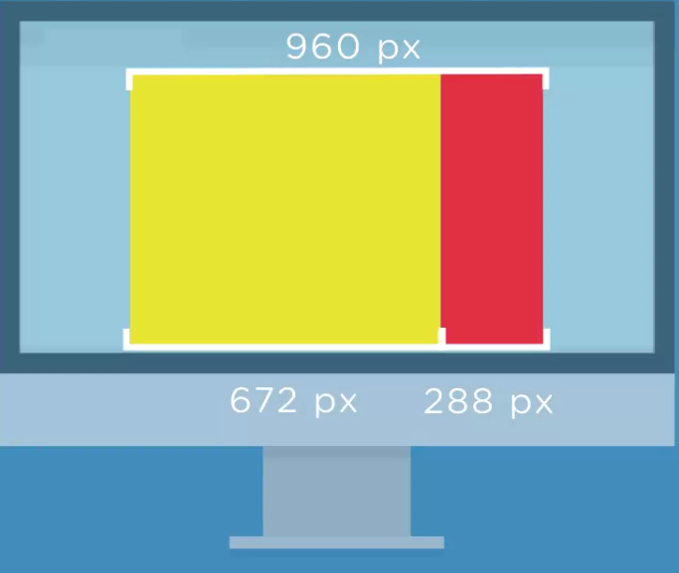
Bootstrap 1
Fixed Website Layouts A fixed website layout has a wrapper that is a fixed width, and the components inside it have either percentage widths or fixed widths. The important thing is that the container (wrapper) element is set to not move. No matter what screen resolution the visitor has, he or she will see the same width as other visitors. (similar to print)
Fluid/Flexible- respond as browser size or screen changes. Limited when really large or really small. (2 column layout by % stretches screen)
elements that use percentage are relative to their parent container

Slide 12
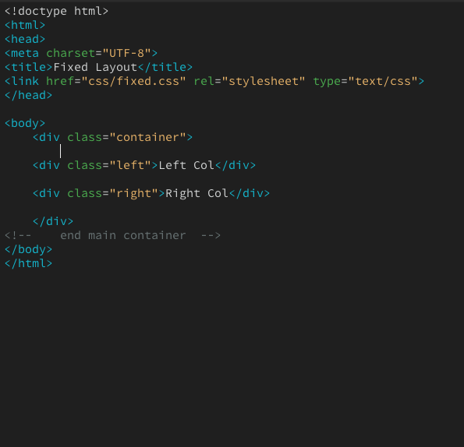
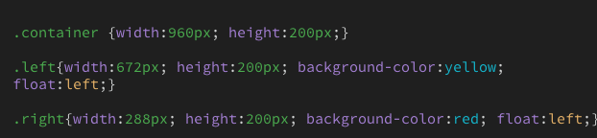
Bootstrap 1
Fixed Layouts- When px for the width. The boxes get cut off at 959px

Slide 13
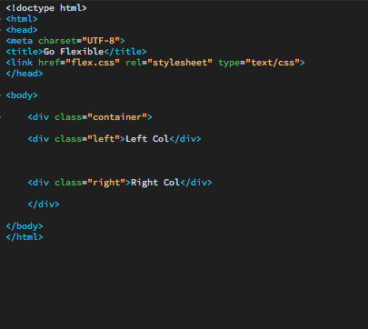
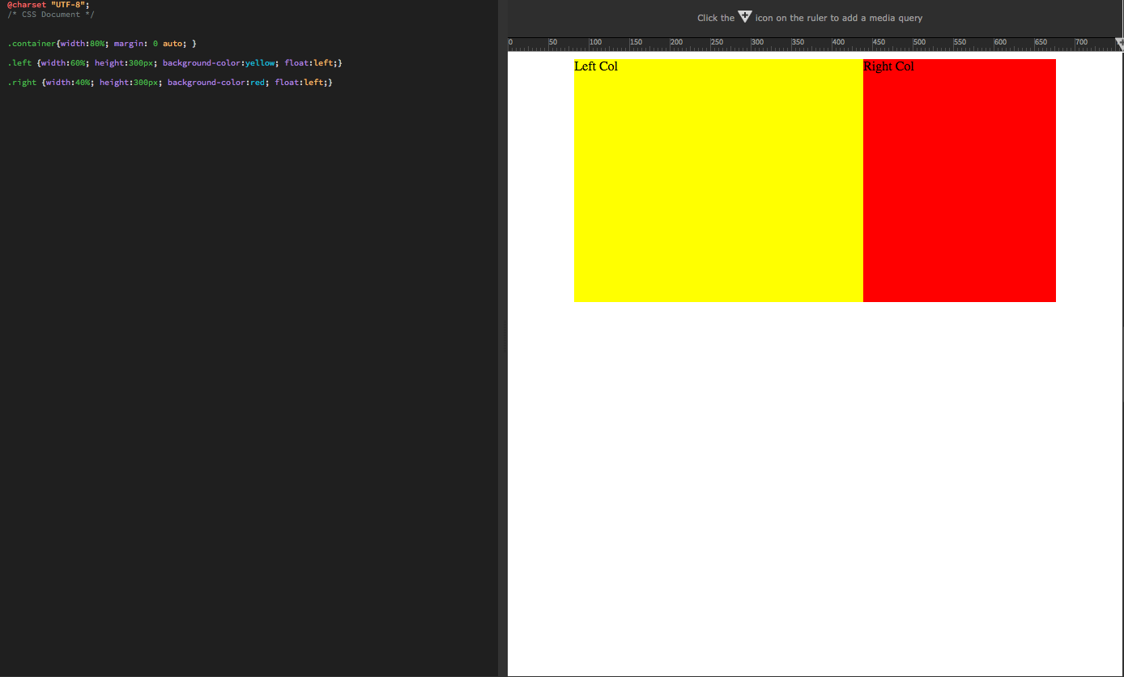
Bootstrap 1
Flexible Layouts- When using % for the width. The boxes within the parent box stretch to width of that box yet still maintain their size

Slide 14
Bootstrap 1
Adaptive / Responsive Design
Used when you switch from multi-column to single column layouts
Changes Content as it scales up or down
They Use:
Viewport
Media Queries
Breakpoints
Flexible Media

Slide 15
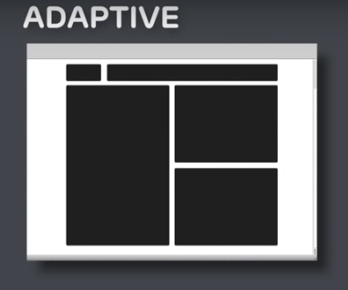
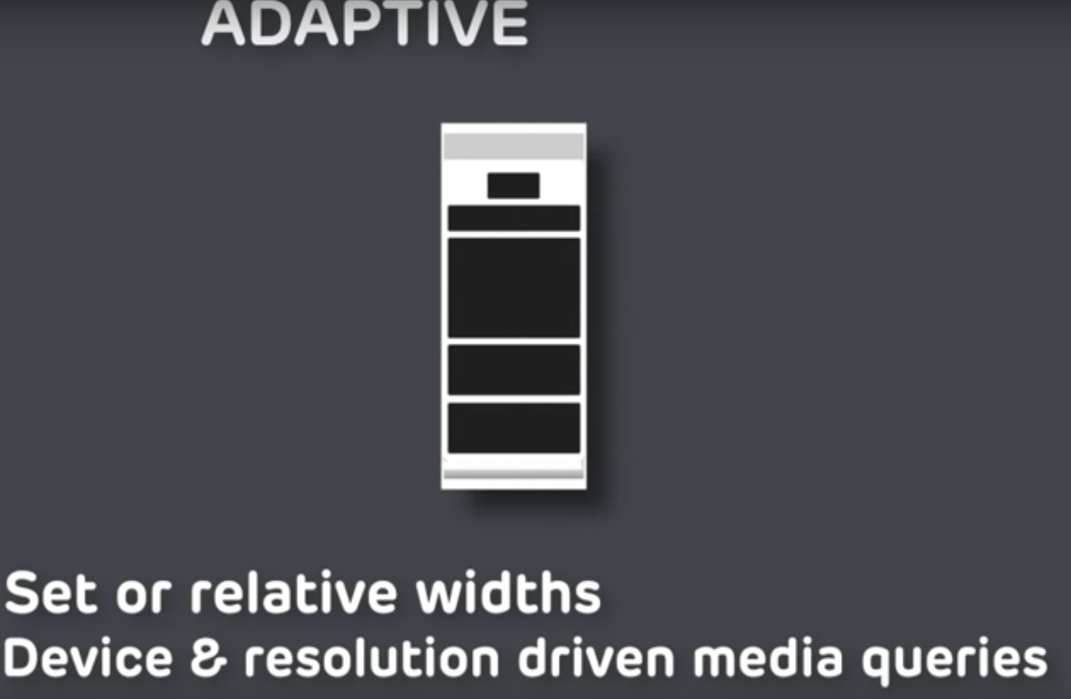
Bootstrap 1

Slide 16
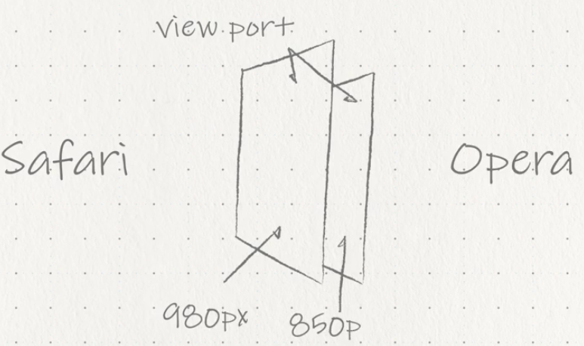
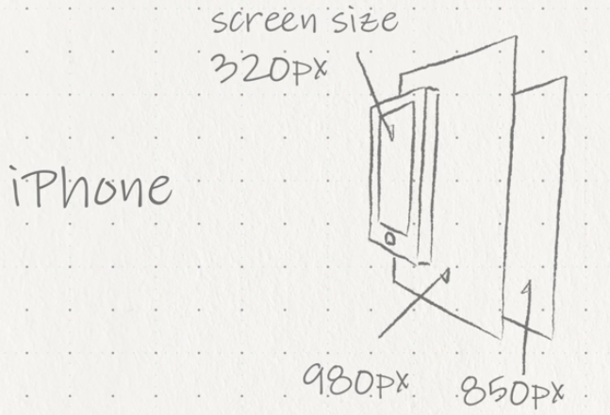
Bootstrap 1
Understanding the viewport
Area within the window of the browser/app independent of the screen
What happens to content as you zoom in and out, ensures proper rendering for all size screens
Designed to be larger than the screens resolution
Browsers will display a web page within the viewport and then shrink that viewport down until the content fits within the width of the screen itself. (Allows Zoom and to see the page entirely)
Browser VS Screen Size of iPhone

Slide 17
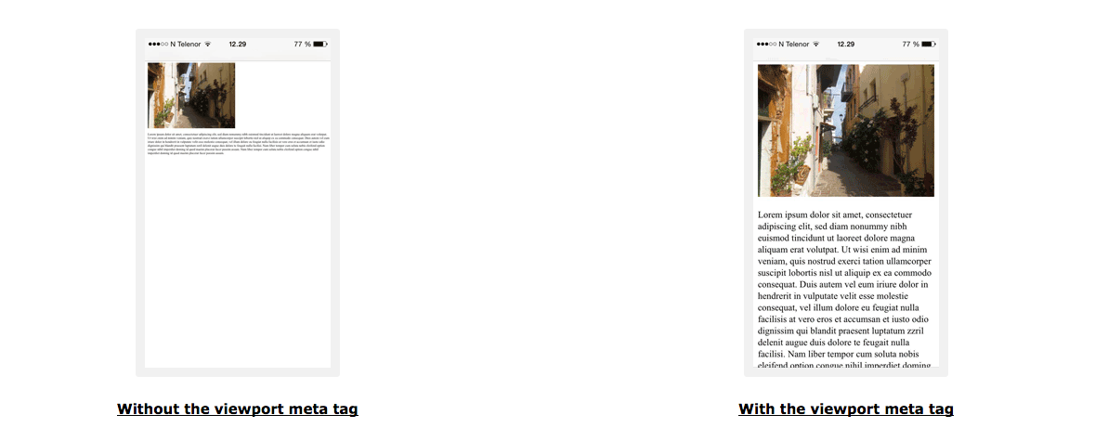
Bootstrap 1
Understanding the viewport
The viewport meta tag allows you to simply use max and min-width that span from desktop to mobile devices. The width property controls the size of the viewport. Width of the screen in CSS pixels at a scale of 100%,The initial-scale property controls the zoom level when the page is first loaded.

Slide 18
Bootstrap 1
Setting The Viewport
HTML5 introduced a method to let web designers take control over the viewport, through the <meta> tag.
You should include the following <meta> viewport element in all your web pages:
<meta name="viewport" content="width=device-width, initial-scale=1.0">
A <meta> viewport element gives the browser instructions on how to control the page's dimensions and scaling.
The width=device-width part sets the width of the page to follow the screen-width of the device (which will vary depending on the device).
The initial-scale=1.0 part sets the initial zoom level when the page is first loaded by the browser.

Slide 19
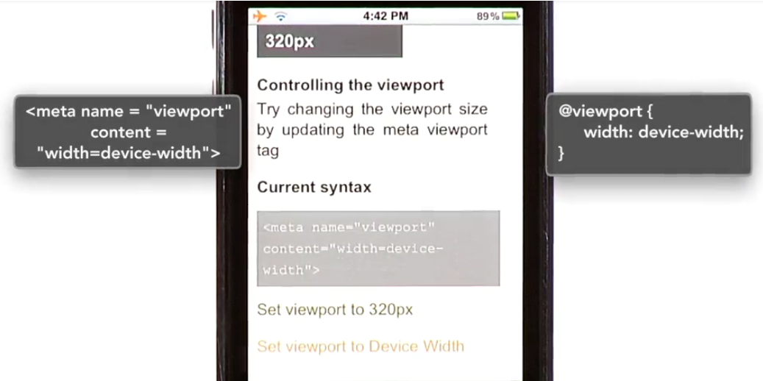
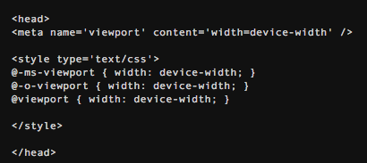
Bootstrap 1
Controlling Viewport
Used to respond on a phone or tablet to change sizes
Can use exact pixels but device-width scales to any device
2 Ways you can add viewport (meta tag, @viewport in CSS)
Should use both meta tag and @viewport for browser supportability
Viewport Meta Tag (Goes in between <head></head>)
Uses -
Name- which is viewport
Content- which will contain the properties and values you wish to set for the viewport itself. (i.e device-width
@Viewport CSS -
Place at the top of your CSS before media query
Selector -@viewport
Declaration- width:device-width;
Limited Support

Slide 20
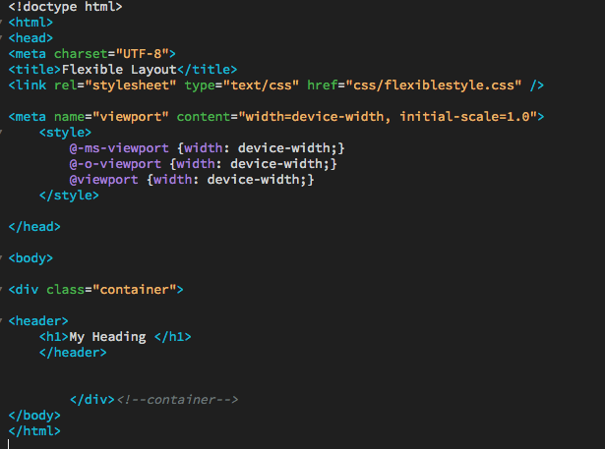
Bootstrap 1
Controlling Viewport
Example with HTML Viewport Meta Tag and CSS Internal Styling Declarations
Note: Generally
CSS will go in
external stylesheet

Slide 21
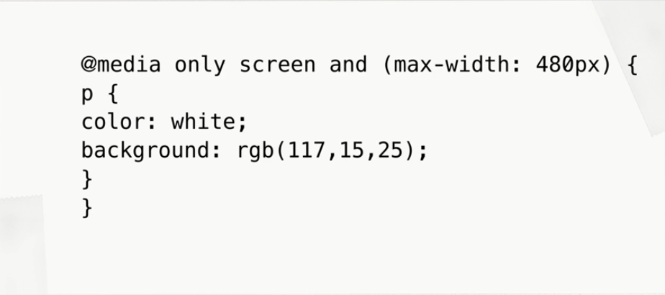
Bootstrap 1
Media Queries
Media Queries, Viewport and Breakpoints-Media query is a CSS rules or technique introduced in CSS3. It uses the @media rule to include a block of CSS properties only if a certain condition is true (i.e screen size).
Flexible Media- If the width property is set to 100%, the image will be responsive and scale up and down. Can also set the image height to auto
Mozilla Developer Network
https://developer.mozilla.org/en-US/docs/Web/CSS/Media_Queries
Example @ media in CSS File
Full List: https://www.w3.org/TR/css3-mediaqueries/

Slide 22
Bootstrap 1
Class Samples Summary (same info just different css)
fixed.html -defined in the body as 960px fixed
flex.html - uses % on widths, padding on css elements
responsive.html - once it hits a breakpoint or size the layout or CSS changes 3 column-->2 Column-->1 Column as you resize

Slide 23
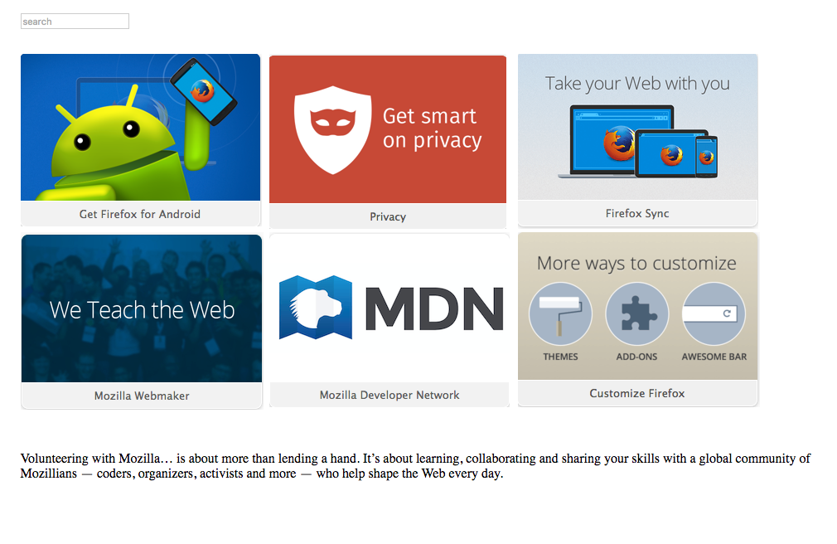
Bootstrap 1
Create a new HTML 5 page that looks like the following with a fixed layout (960px width)(instructor will send images: fixed-images.zip)
Save the html page to public_html/class-samples/fixedlayout.html
Save the CSS page to public_html/class-samples/css/fixedlayout.css

Slide 24
Bootstrap 1
Modify the fixed layout and make it flexible
Save fixedlayout.html as public_html/class-samples/flexiblelayout.html
Save the CSS page to public_html/class-samples/css/flexiblelayout.css
Add viewport Meta Tags to HTML and CSS and add % to the width on all containers

Slide 25
Bootstrap 1
Creating Breakpoints with Media Queries
A breakpoint indicates the moment your layout switches from one layout/device to another, and is usually triggered by the width of a screen. Uses min-width and/or max-width properties. Min Width Most common
Breakpoints should only be introduced when a website starts to break, look weird, or the experience is being hampered.
(3 Basic /Most Common Break Points) The screen sizes are based on the typical screen sizes for smartphones, tablets, and desktop devices. These breakpoints should be defined for your layout

Slide 26
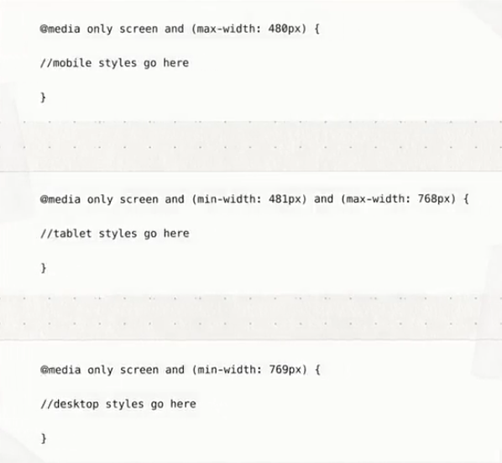
Bootstrap 1
(3 Basic /Common Break Points)
This can vary based on content
SYNTAX:
@media only screen and (max-width: 600px) {
Css selector {
Css attribute: CSS Value;
}
}

Slide 27
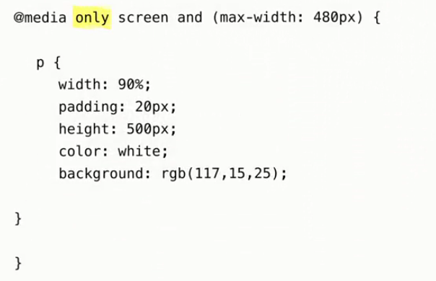
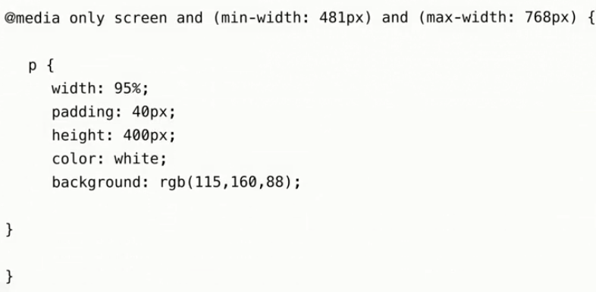
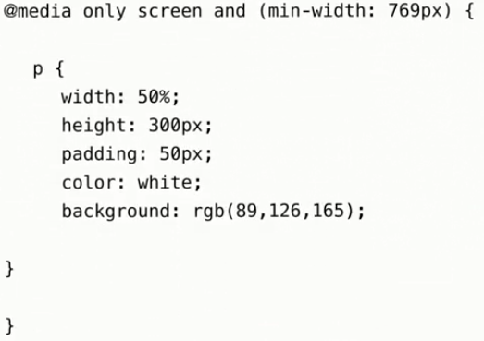
Bootstrap 1
Media Queries
Note that each of the media queries uses the only keyword, which hide the styles from older non-conforming user agents.
Because of this, you will want to have a set of default CSS styles to fall back on.
The screen media types ensure that the styles apply to screen-based devices.
The mobile media query uses the maximum-width media property to restrict styles to screens under 481 pixels, which should target the majority of smartphone devices.
The tablet media query uses slightly longer syntax, by combining both a minimum and a maximum-width media property to define a specific range of screen sizes.

Slide 28
Bootstrap 1
Flexible Media & Breakpoints
NOTE: One quick way to make media/pictures scalable is by using the max-width property with a value of 100%. The video player will scale down if it has to, but never scale up to be larger than its original size:
img, video, canvas {
max-width: 100%;
height:auto;
}
Creating breakpoints with media queries is an important part of responsive design, it's only the first step to creating responsive layouts.
To create a layout that's truly responsive, you'll need to combine these breakpoints with fluid grids.

Slide 29
Bootstrap 1
Create a new page called breakpoint1.html and save it to public_html/class-samples/
Create a new page called breakpoint1.css and save it to public_html/class-samples/css
Make a header container and set it to 960px width and height 200px, background color of blue, with text “This is the home page”.
Set 2 max-width breakpoints with media queries at 960px and 768px
Change the <body> background color to green at the 960px breakpoint
Change the <body> background color to gray at the 768px breakpoint
Flexible Media & Breakpoints Exercise 1

Slide 30
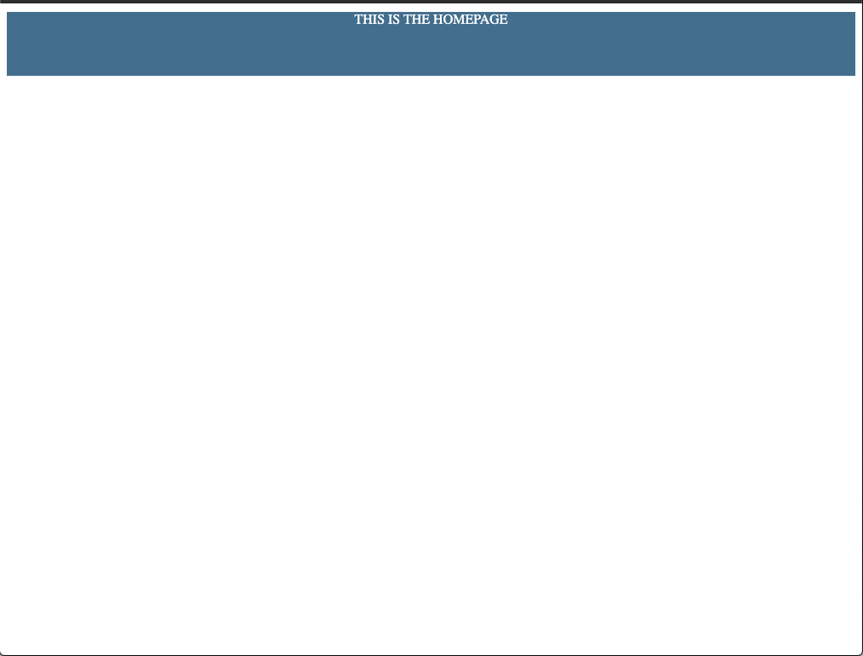
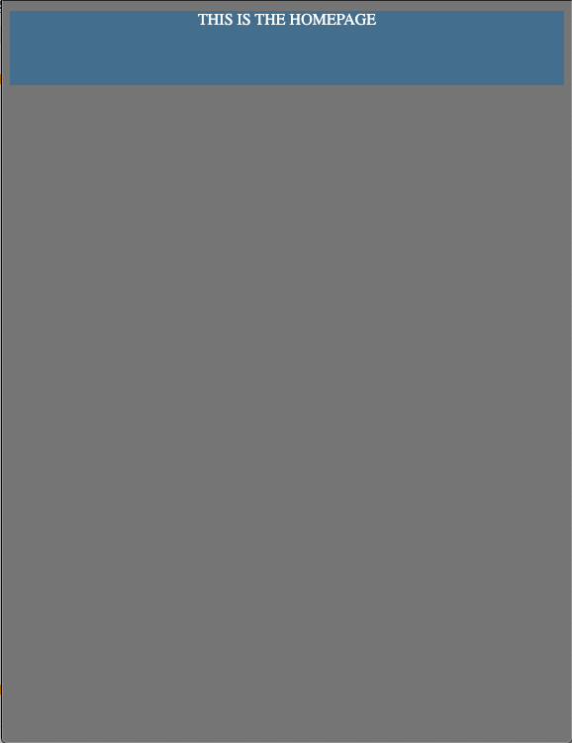
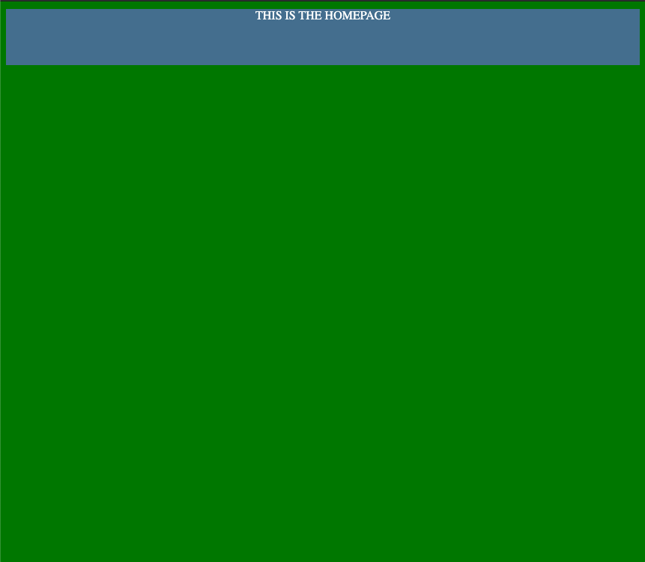
Bootstrap 1
Flexible Media & Breakpoints Exercise 1

Slide 31
Bootstrap 1
Create a new page called breakpoint2.html and save it to public_html/class-samples/
Create a new page called breakpoint2.css and save it to public_html/class-samples/css
Make a container and set it to 1024px width
Create 2 articles that have a 512px width one, with a gray background and one with a black background, displayed side by side
Stack them at the 960px breakpoint and below
Set 3 max-width breakpoints with media queries make the box size height larger at each point
Make the font size larger each time at the 960px breakpoint and below
Flexible Media & Breakpoints Exercise 2

Slide 32

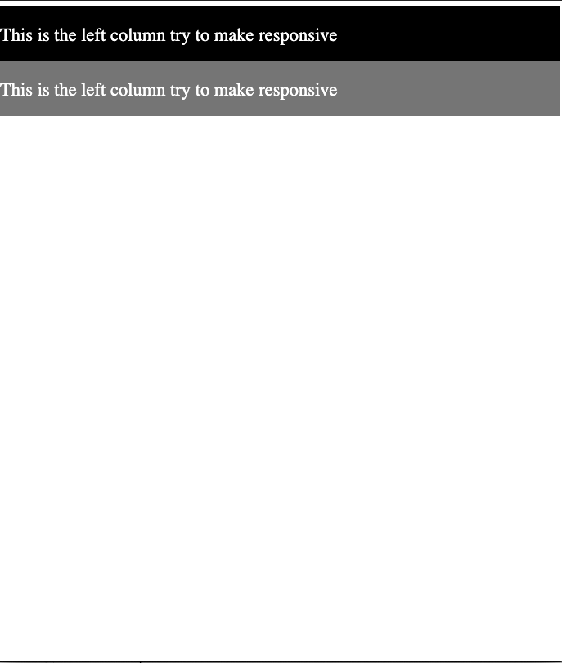
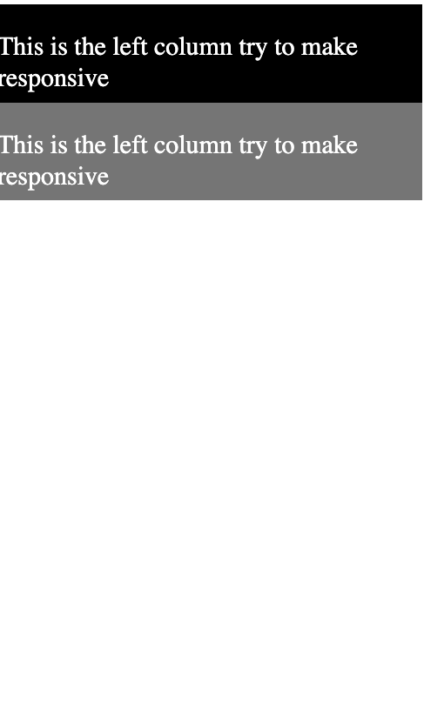
Bootstrap 1
Flexible Media & Breakpoints Exercise 2
1024px
960px
680px

Slide 33
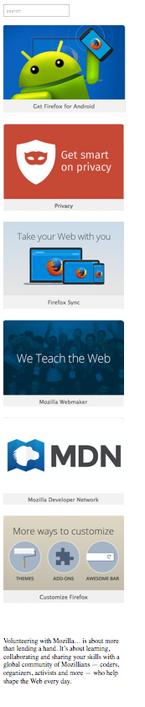
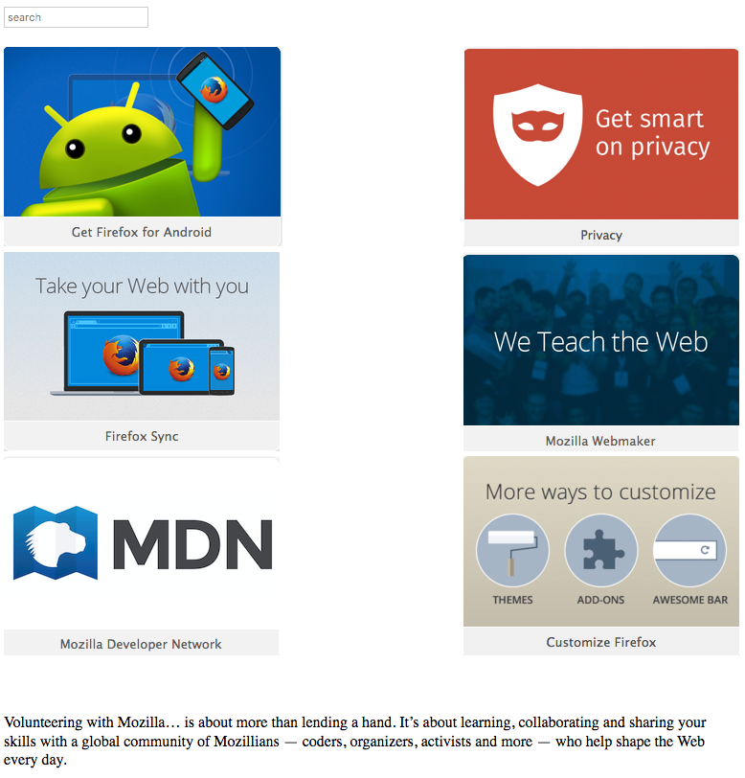
Bootstrap 1
Modify the flexible layout and make it responsive
Save flexiblelayout.html as public_html/class-samples/responsivelayout.html
Save the css page to public_html/class-samples/css/responsivelayout.css
Add @Media Breakpoints (hint: 959px and 774px) to collapse images
At 959px
At 774px

Slide 34
Bootstrap & Frameworks

Slide 35
Bootstrap 1
Frontend Frameworks
The framework aims to alleviate the overhead associated with common activities performed in web development. They are preset CSS classes that can be modified for use on your sites.
Contain predefined CSS classes that set breakpoints and make the site responsive.
For example, many frameworks provide libraries for database access, templating frameworks and session management, and they often promote code reuse.

Slide 36
Bootstrap 1
http://www.sitepoint.com/5-most-popular-frontend-frameworks-compared/
http://noeticforce.com/css-front-end-frameworks-for-web-development-and-design
https://www.w3schools.com/css/css_rwd_frameworks.asp
http://www.html5reset.org
Frontend Framework Examples

Slide 37
Bootstrap 1
Intro to Bootstrap and Frameworks
What is Bootstrap?
Where can I access it?
Where do I put it?

Slide 38
Bootstrap 1
What Is Bootstrap?
Bootstrap is a free front-end framework for faster and easier web development
Bootstrap includes HTML and CSS based design templates for typography, forms, buttons, grids, tables, navigation, modals, image carousels and many other. (Uses a link to a CSS file) and you reference class names from the framework.
Bootstrap 4 is based on Flexbox and is only supported in IE 9 or above.
(flexbox, is a layout mode intended to accommodate different screen sizes and different display devices. ... The display order of flexbox elements is independent of their order in the source code)
Bootstrap contains JavaScript plugins for adding interactivity and for some pre-built components. (uses a library that is referenced in your html page)
Bootstrap also gives you the ability to easily create responsive designs.
Bootstrap is compatible and/or supports all browsers
URL: http://getbootstrap.com/
Current version: 4.4.1
Before Bootstrap, various libraries were used for interface development, which led to inconsistencies and a high maintenance burden.

Slide 39
Bootstrap 1
Advantages of Bootstrap and Frameworks
Faster Development/ Site Design
Reusable code for common HTML and CSS
Built-in Custom Javascript Plug-ins
Cross Browser and Screen Compatibility

Slide 40
Navigating the Documentation

Slide 41
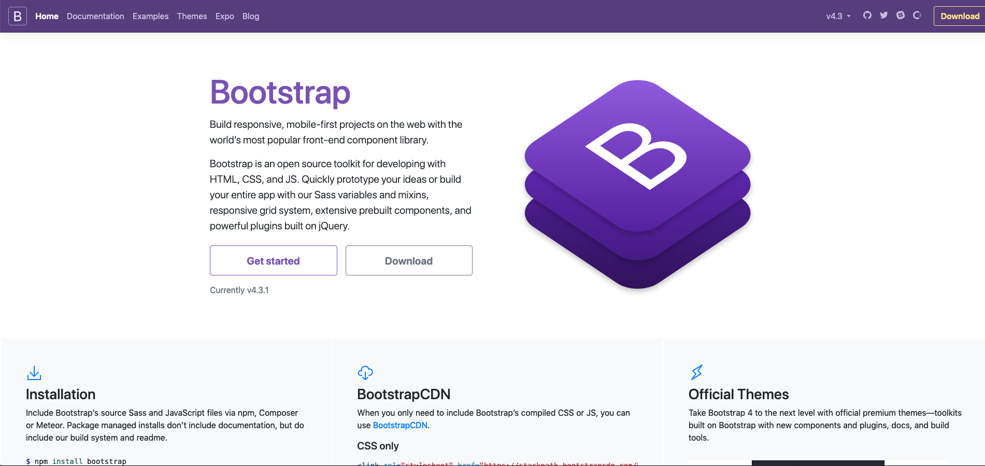
Bootstrap 1
Bootstrap Site Overview
https://getbootstrap.com/docs/4.4/getting-started/introduction/
Current: https://getbootstrap.com/

Slide 42
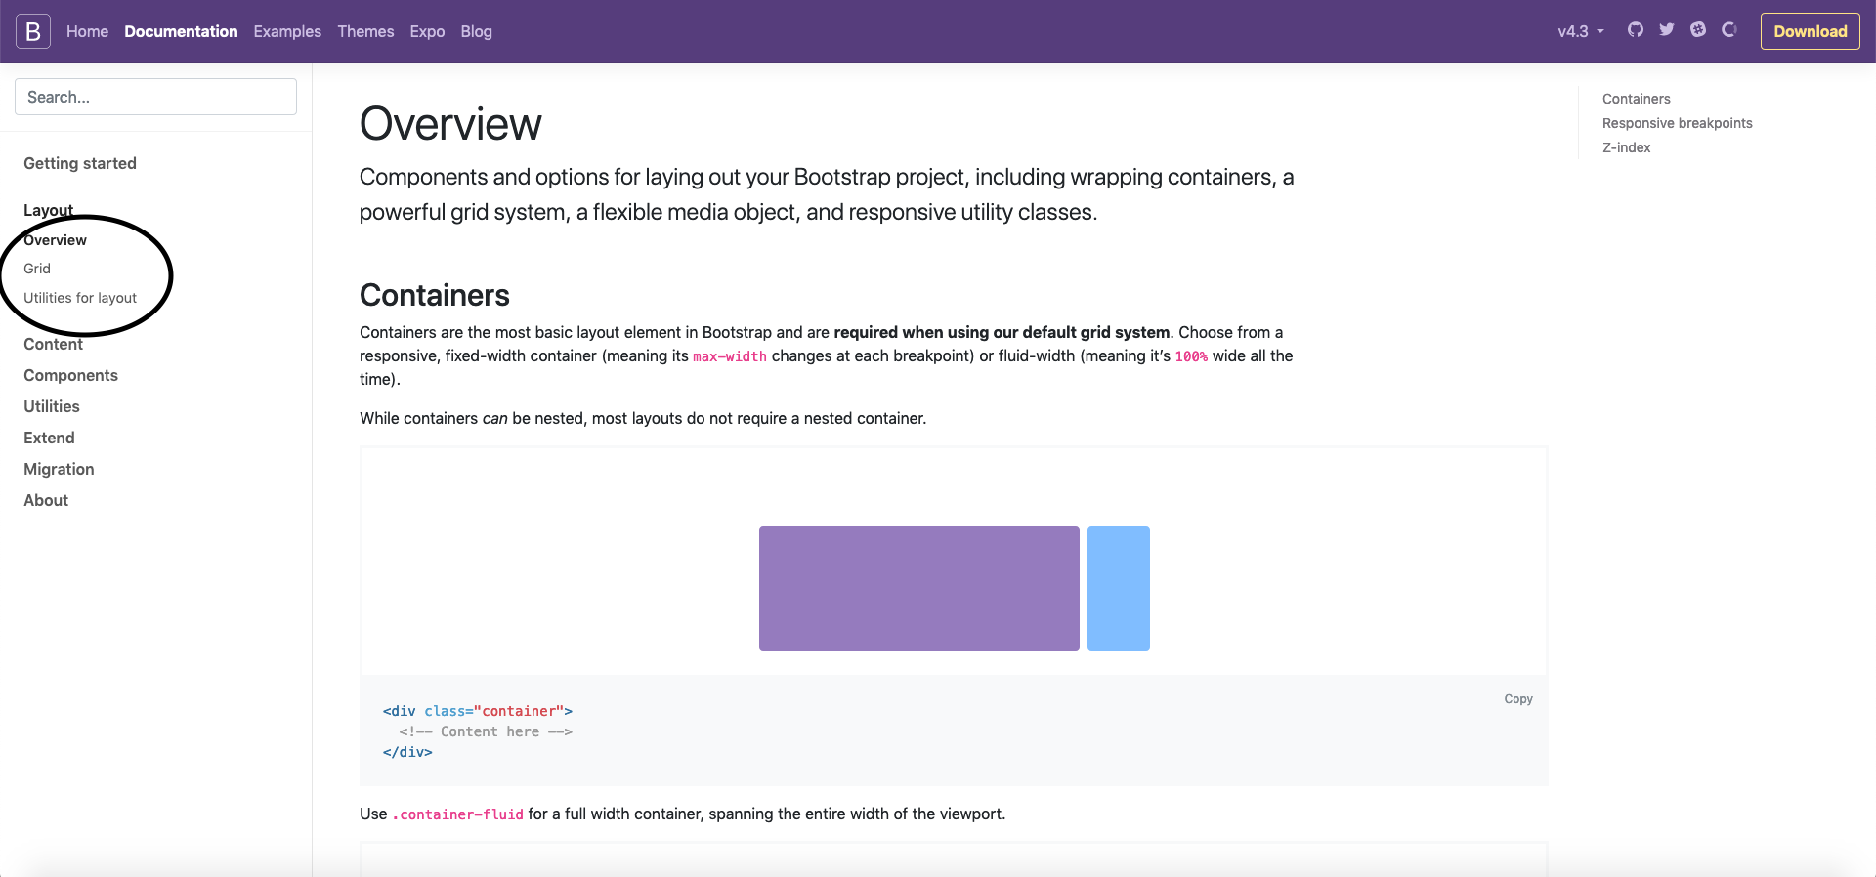
Bootstrap 1
https://getbootstrap.com/docs/4.4/layout/overview/
Bootstrap - comes with many options to layout your designs
Containers
Grid System
Media Objects
Utilities for Layout

Slide 43
Bootstrap 1
Pre-built Content
Type
Images
Forms
Tables
Bootstrap Framework Breakdown
Pre-built Classes Using CSS
Grids
Tables
Forms
Buttons
Images
Pre-built Components
Dropdowns
Navigation
Headers
Cards
List Groups
Buttons
Pre-built Components Requiring Javascript
Transitions
Modals
Interactive Dropdowns
Carousels
Toggles and collapsing

Slide 44
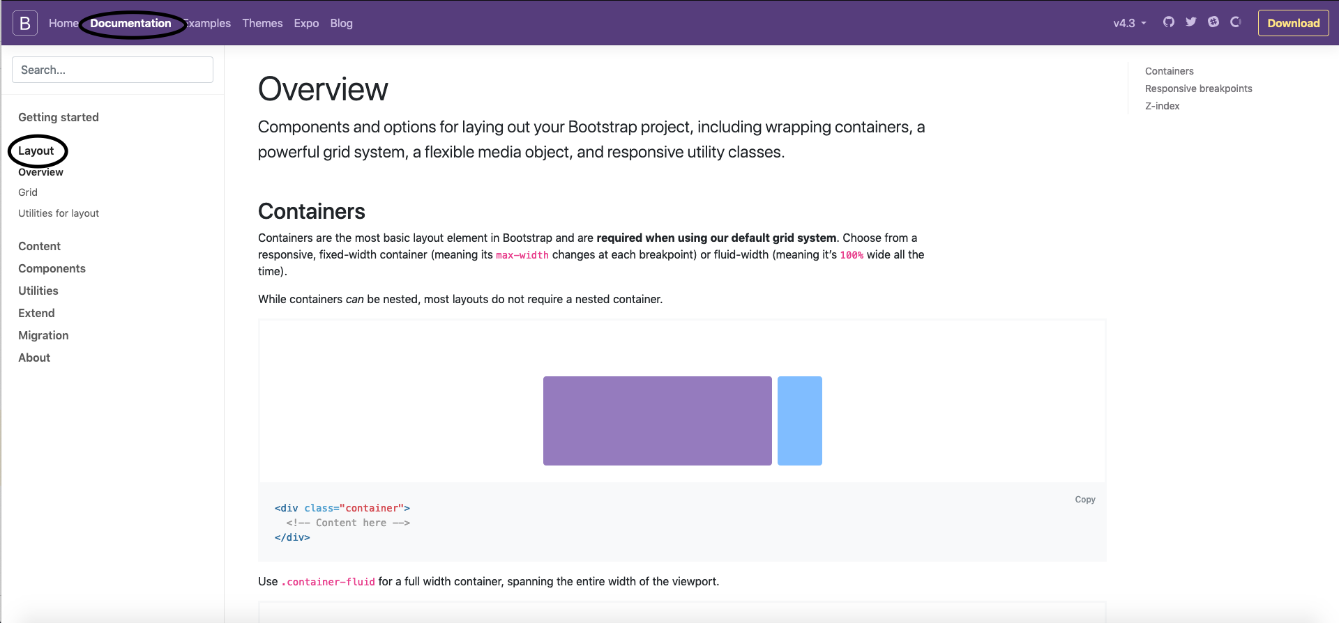
Bootstrap 1
Bootstrap Framework Breakdown
Pre-built Layout Classes Using CSS
https://getbootstrap.com/docs/4.4/layout/overview/

Slide 45
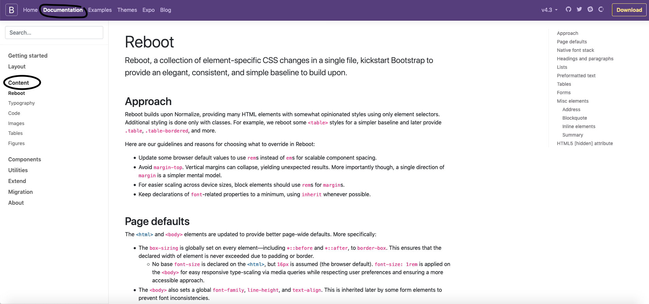
Bootstrap 1
Bootstrap Framework Breakdown
Pre-built Content -
https://getbootstrap.com/docs/4.4/content/typography/

Slide 46
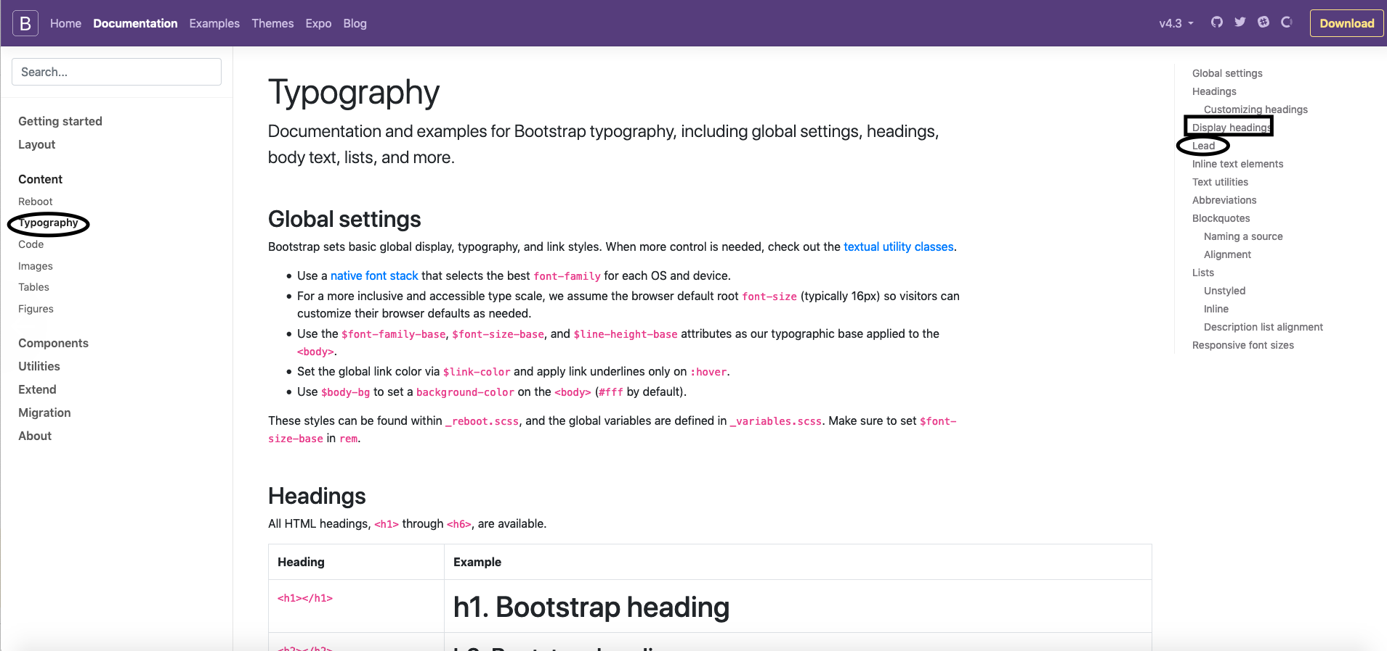
Bootstrap 1
Bootstrap Framework Breakdown
Headings and Text Utilities
Uses classes for making type stand out like display, mute and lead
TYPE: https://getbootstrap.com/docs/4.4/content/typography/

Slide 47
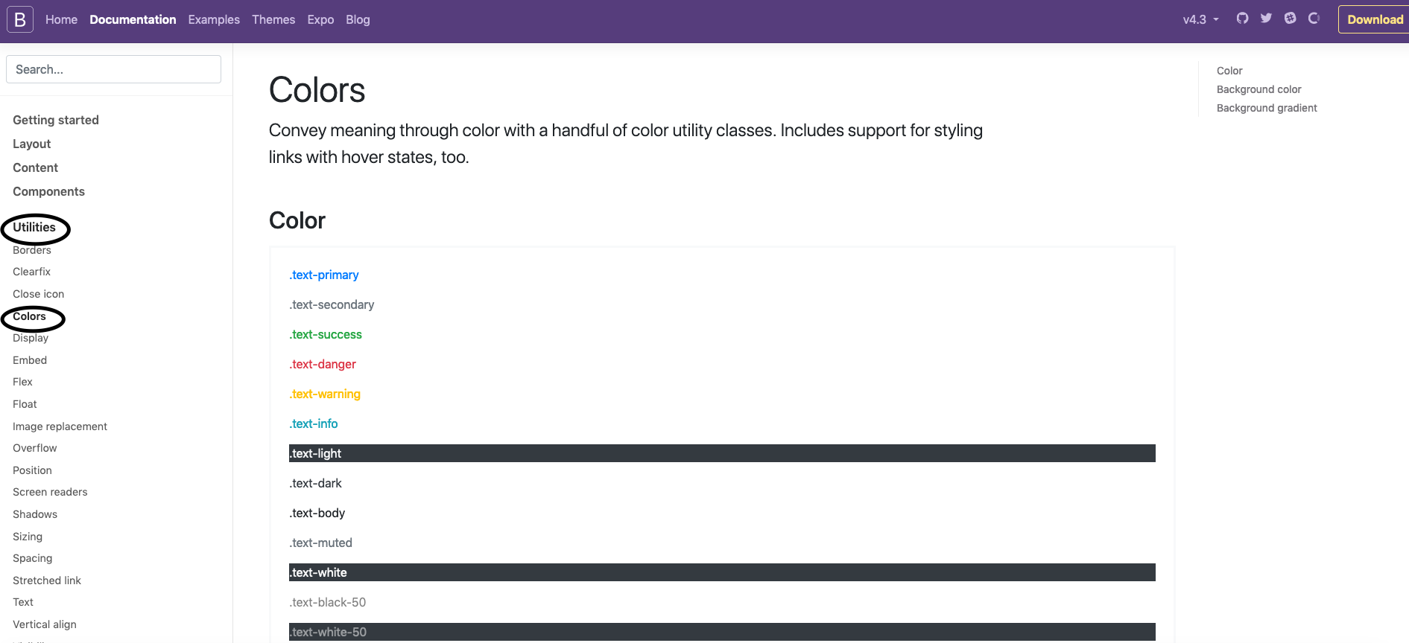
Bootstrap 1
Bootstrap Framework Breakdown
Headings and Text Utilities
Uses classes for color like text-primary text-secondary
TEXT:
https://getbootstrap.com/docs/4.4/content/typography/

Slide 48
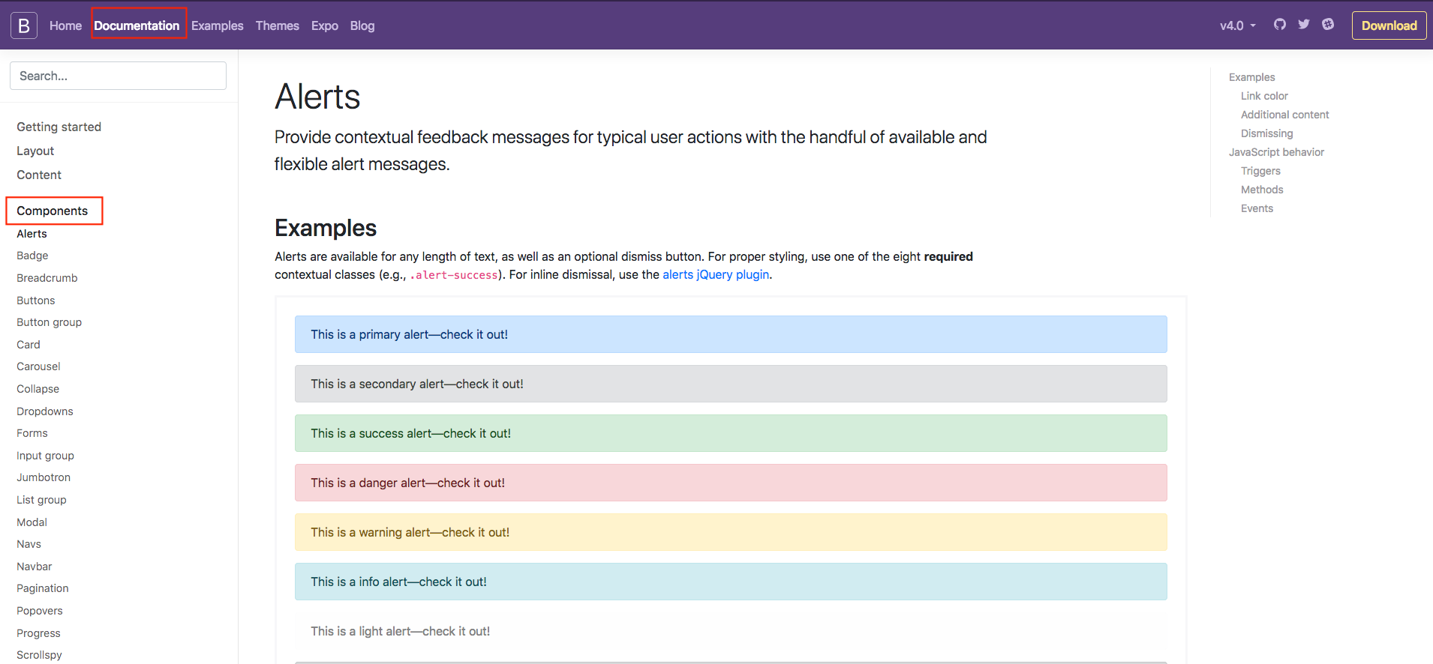
Bootstrap 1
Pre-built Components https://getbootstrap.com/docs/4.4/components/alerts/
Bootstrap Framework Breakdown

Slide 49
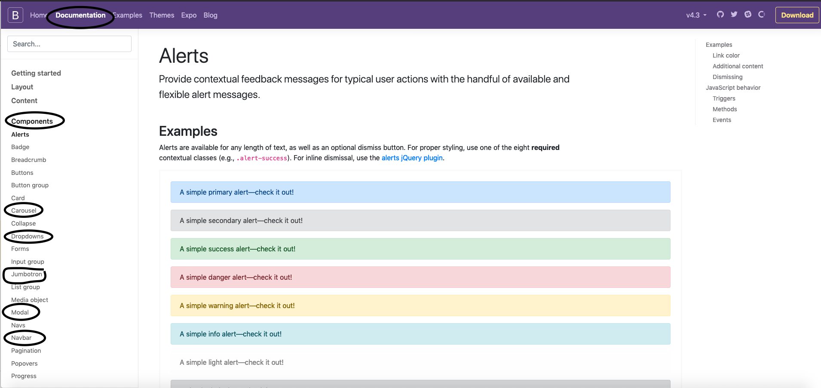
Bootstrap 1
Pre-built Components Requiring Javascript
https://getbootstrap.com/docs/4.4/components/alerts/
Bootstrap Framework Breakdown

Slide 50
Bootstrap 1
Where to Get/Access Bootstrap? 1st Step
There are two ways to start using Bootstrap on your own web site. Either (Locally or linking to a CDN)
Locally:
1: Download Bootstrap from getbootstrap.com and reference the library locally from your HTML page
CSS:
<link rel="stylesheet" href= "bootstrap/4.4/css/bootstrap.min.css">
Javascript:
<script src="jquery-3.4.1.slim.min.js" ></script>
<script src="popper.min.js" i></script>
<script src="bootstrap/4.4.1/js/bootstrap.min.js" ></script>

Slide 51
Bootstrap 1
Where to Get Bootstrap? 1st Step
There are two ways to start using Bootstrap on your own web site.
Linking to a CDN (Content Delivery Network)
2: Include Bootstrap from a CDN or hosted CSS library between <head></head>
<link rel="stylesheet" href="https://stackpath.bootstrapcdn.com/bootstrap/4.4.1/css/bootstrap.min.css" integrity="sha384-Vkoo8x4CGsO3+Hhxv8T/Q5PaXtkKtu6ug5TOeNV6gBiFeWPGFN9MuhOf23Q9Ifjh" crossorigin="anonymous">
The Javascript and Popper Files are needed if you are using interactivity (bottom of the page before </body>)
<script src="https://code.jquery.com/jquery-3.4.1.slim.min.js" integrity="sha384-J6qa4849blE2+poT4WnyKhv5vZF5SrPo0iEjwBvKU7imGFAV0wwj1yYfoRSJoZ+n" crossorigin="anonymous"></script>
<script src="https://cdn.jsdelivr.net/npm/popper.js@1.16.0/dist/umd/popper.min.js" integrity="sha384-Q6E9RHvbIyZFJoft+2mJbHaEWldlvI9IOYy5n3zV9zzTtmI3UksdQRVvoxMfooAo" crossorigin="anonymous"></script>
<script src="https://stackpath.bootstrapcdn.com/bootstrap/4.4.1/js/bootstrap.min.js" integrity="sha384-wfSDF2E50Y2D1uUdj0O3uMBJnjuUD4Ih7YwaYd1iqfktj0Uod8GCExl3Og8ifwB6" crossorigin="anonymous"></script>

Slide 52
Bootstrap 1
Bootstrap: 2nd Step- Add Viewport and Container
Add your container box <div class= “container”></div>. Bootstrap also requires a containing element to wrap site contents.
Add your Viewport for Zoom & Rendering - (Goes in between <head></head>)
<meta name="viewport" content="width=device-width, initial-scale=1.0">
There are two options for container classes to choose from:
.container class provides a responsive fixed width container
(centers content and sets max-width)
.container-fluid class provides a full width container, spanning the entire width of the viewport

Slide 53
Bootstrap 1
Bootstrap: 3rd Step-Starter Page Example
<!doctype html>
<html lang="en">
<head>
<!-- Required meta tags -->
<meta charset="utf-8">
<meta name="viewport" content="width=device-width, initial-scale=1, shrink-to-fit=no">
<!-- Bootstrap CSS -->
<link rel="stylesheet" href="https://stackpath.bootstrapcdn.com/bootstrap/4.4.1/css/bootstrap.min.css" integrity="sha384-Vkoo8x4CGsO3+Hhxv8T/Q5PaXtkKtu6ug5TOeNV6gBiFeWPGFN9MuhOf23Q9Ifjh" crossorigin="anonymous">
<title>Hello, world!</title>
</head>
<body>
<h1>Hello, world!</h1>
<!-- Optional JavaScript -->
<!-- jQuery first, then Popper.js, then Bootstrap JS -->
<script src="https://code.jquery.com/jquery-3.4.1.slim.min.js" integrity="sha384-J6qa4849blE2+poT4WnyKhv5vZF5SrPo0iEjwBvKU7imGFAV0wwj1yYfoRSJoZ+n" crossorigin="anonymous"></script>
<script src="https://cdn.jsdelivr.net/npm/popper.js@1.16.0/dist/umd/popper.min.js" integrity="sha384-Q6E9RHvbIyZFJoft+2mJbHaEWldlvI9IOYy5n3zV9zzTtmI3UksdQRVvoxMfooAo" crossorigin="anonymous"></script>
<script src="https://stackpath.bootstrapcdn.com/bootstrap/4.4.1/js/bootstrap.min.js" integrity="sha384-wfSDF2E50Y2D1uUdj0O3uMBJnjuUD4Ih7YwaYd1iqfktj0Uod8GCExl3Og8ifwB6" crossorigin="anonymous"></script>
</body>
</html>
Basic Template

Slide 54
Bootstrap 1
Bootstrap Classes
Primary Classes are built-in (the library has the CSS defined)
Have Modifier or Utility Classes- Help setup the content and sometimes make it stand out <p class="lead">
Have Helper Classes- Help style the classes further
<p class="text-primary”>
Modifier/Utility Classes and Helper Classes are placed next to each other in the selector (<li class="btn btn-success">Home</li>)
Can reference multiple classes and their helpers in your class calls

Slide 55
Bootstrap 1
Bootstrap Typography or Text Heading & Text Utilities
Used to showcase content or sections of the page:
Header Display Class:
Under Documentation +Typography + Display headings
.class="display-1" (sizes 1-4)
Helper Heading or Paragraph Classes add emphasis and style:
Additional CSS that can format paragraphs and set as main paragraph with formatting (lead) <p class="lead"> also makes it appear smaller in viewport
Text Utility Classes- sets up the content and its alignment:
.class="text-center "
https://getbootstrap.com/docs/4.4/utilities/text/
https://getbootstrap.com/docs/4.4/utilities/colors/

Slide 56
Bootstrap 1
Bootstrap Container- Components For Layouts
Containers are the most basic layout element in Bootstrap and are required when using our default grid system. Choose from a responsive, fixed-width container (meaning its max-width changes at each breakpoint) or fluid-width (meaning it’s 100% wide on the viewport all the time).
https://getbootstrap.com/docs/4.4/layout/overview/
Container Classes:
Under documentation + layout on BS website
<div class="container"></div> (sized and margin on either side)
<div class="container-fluid"></div> (full width of the page)
NOTE: Containers or nesting containers can get confusing so comment each.
Command + CNTRL + /

Slide 57
Bootstrap 1
Bootstrap Container- Utility Classes
Borders border (top, right bottom, left)
Text lead (emphasizes), colors, sizes, alignment
lead (emphasizes headings or paragraphs)
Spacing m(margin) x, y (top, bottom, right, left, auto) t, b, r, l , auto or # of space (total space)
Sizing display (size) # (how big)
Colors primary, secondary, success, danger, warning, info
Classes can be combined with Utility Classes:
Under components + layouts +utilities on BS website
<div class="container text-center"></div>
Note: you can place everything in the primary container and center it that way, or you can use another utility class: (m standing for margin x standing for right and left auto or # value is space)
Under components + layouts +utilities + Spacing on BS website
class="mx-auto”
https://getbootstrap.com/docs/4.4/utilities/spacing/

Slide 58
Bootstrap 1
EXAMPLE
<div class="mx-auto">
<div class="input-group">
<input type="text" class="form-control" aria-label="Enter Your Email Info" placeholder="Enter Your Email Info">
<span class="input-group-button">
<button class="btn btn-secondary" type="button">Sign Up!</button>
</span>
</div>
</div>
Bootstrap Components + Classes
Forms
Buttons
Jumbotrons
Navs
Etc….
Easily extend form controls by adding text, buttons, or button groups on either side of textual inputs, custom selects, and custom file inputs.Creating responsive form elements:
Buttons and fields have many class options to choose from
Under Documentation, Components + Input Group on BS website
class="input-group" (used to create/group form items) form-control
class="btn" (used to create a button)
class="jumbotron" (used make a section stand out)
class="nav" (used to create a navigation)
https://getbootstrap.com/docs/4.4/components/input-group/

Slide 59
Bootstrap 1
EXAMPLE
<div class="mx-auto">
<div class="input-group">
<input type="text" class="form-control" aria-label="Enter Your Email Info" placeholder="Enter Your Email Info">
<span class="input-group-button">
<button class="btn btn-secondary" type="button">Sign Up!</button>
</span>
</div>
</div>
Bootstrap Components
Form Classes
https://getbootstrap.com/docs/4.4/components/forms/
Under Components + Forms + Input Group on BS website
Easily extend form controls by adding text, buttons, or button groups on either side of textual inputs, custom selects, and custom file inputs.
class="form-group" (used to create/group form items or buttons)
class="input-group" (used to create/group form items or buttons)
class="form-control" (used to create a form control or input)
form-control-lg (used to create a large form control or input)

Slide 60
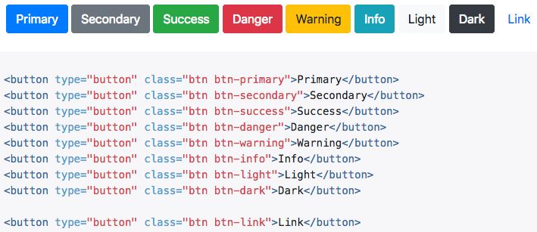
Bootstrap 1
EXAMPLE
<div class=" container mx-auto">
<span class="input-group-button">
<button class="btn btn-secondary" type="button">Sign Up!</button>
</span>
</div>
Bootstrap Components
Button Classes
Under Components + Buttons on BS website
class="btn" (used to create a button)
class="btn-group" (used to group buttons together on a single line)
class="btn-secondary" (used to style a specific type of button with a color)
class="btn-lg" (used set button size sm, lg, block)
https://getbootstrap.com/docs/4.4/components/buttons/

Slide 61
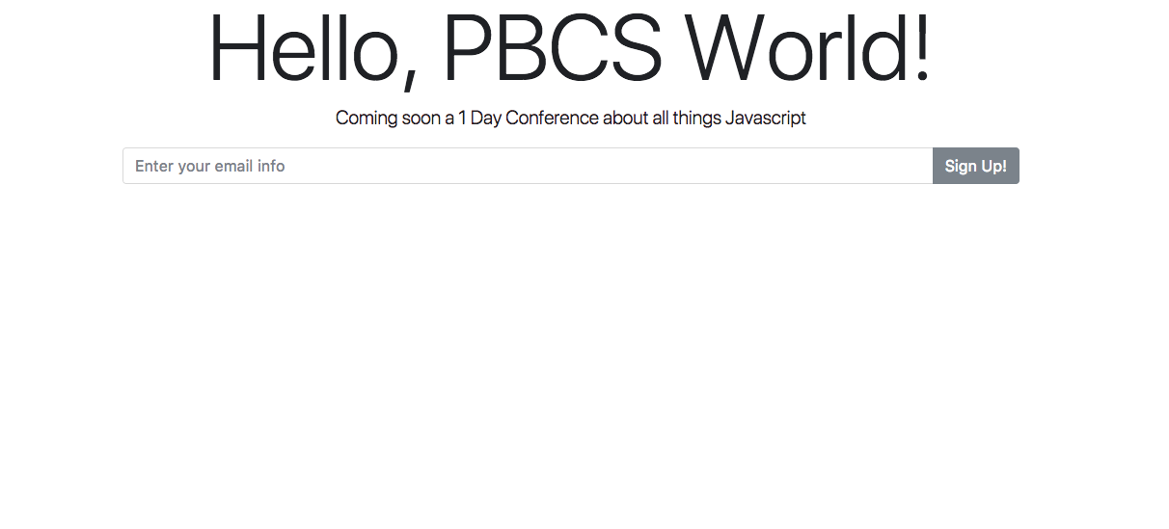
Bootstrap 1
Class Assignment 1
From the instructor’s sample landing page create the following using Utilities, and Component Classes.
Save the page to public_html/class-samples/basics_start.html

Slide 62
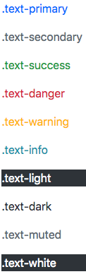
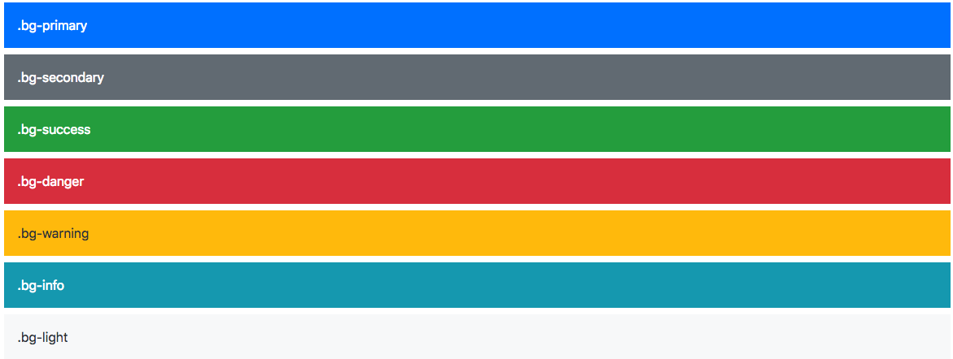
Bootstrap 1
Text Colors
Bootstrap Color Utilities
Used for creating responsive color elements on page and page elements:
https://getbootstrap.com/docs/4.4/utilities/colors/
Colors have many class options to choose from (primary, info, secondary etc.)
Under Utilities + Color on BS website
class="bg-info" (used to create an aqua background)
class="text-primary” (used to create a text color)
Background Colors

Slide 63
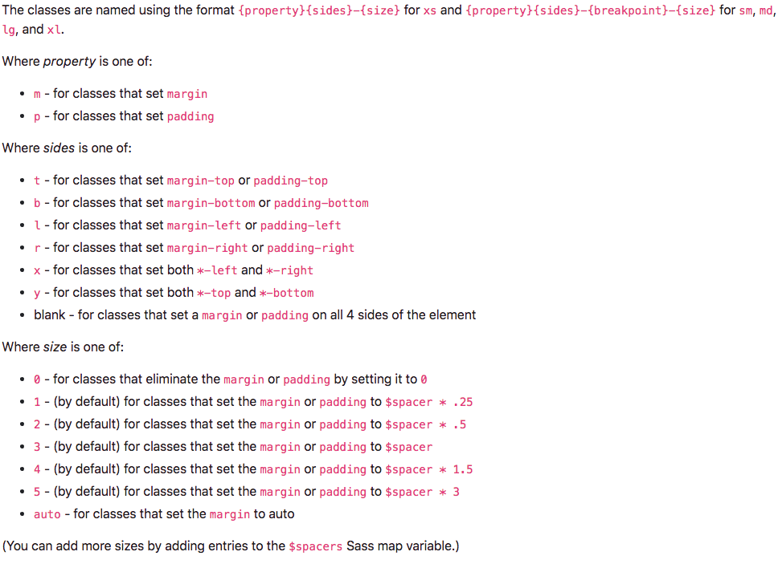
Bootstrap 1
Bootstrap Spacing Utilities
Spacing has many options to choose from for both margin and padding
Uses m- for margin or p- for padding + side (top right bottom left) in ems (0-5 number)
Under Utilities + Spacing on BS website
class="mt-5" (margin top at 3 ems)
class="mb-5" (margin bottom at 3 ems)
class="mx-auto" (margin right/left)
https://getbootstrap.com/docs/4.4/utilities/spacing/

Slide 64
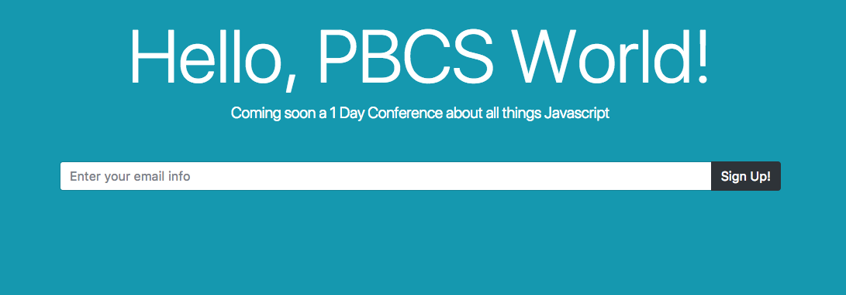
Bootstrap 1
Class Assignment 2
From the instructor’s sample landing page finish the following using Utilities, Content, and Component Classes.
Save the page to public_html/class-samples/basics_start.html

Slide 65
Bootstrap 1
Homework
Complete in class assignments and upload them to the server in the public_html/class-samples folder
Send instructor a link to your assignments
Treehouse lesson: Responsive Layouts [47 min]
https://teamtreehouse.com/library/responsive-layouts
Treehouse lesson: Bootstrap 4 Basics [141 min] https://teamtreehouse.com/library/bootstrap-4-basics-2

Slide 66
End

